Slide 1
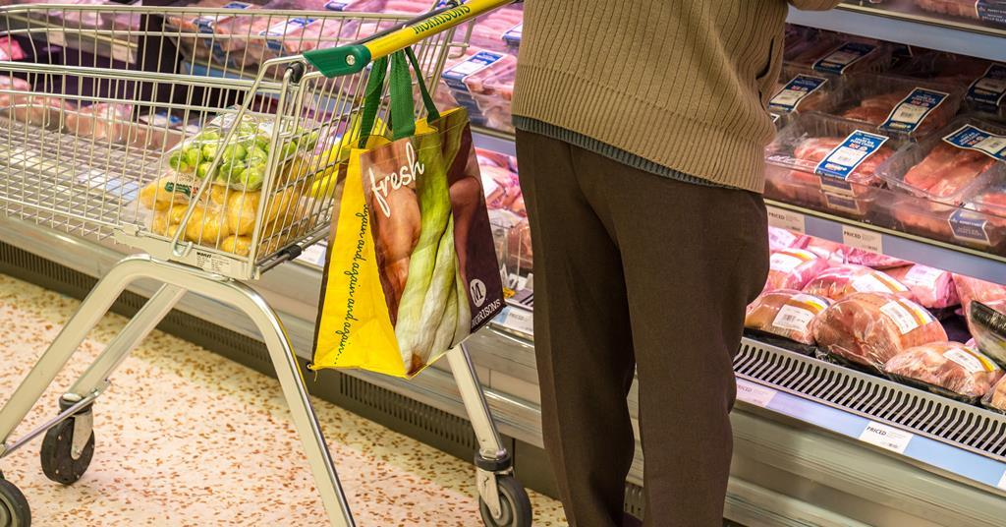
THE GENERATIONAL
🛍
DIVIDE IN
SHOPPING
How Age Shapes Consumer Behavior
in the Digital Era
10,500 customers · 6 age groups · 4 seasons · 6 categories

Slide 2
The Question We Set Out to Answer
Setting the stage for our data story
PROBLEM STATEMENT
"How do generational differences influence consumer shopping behaviour, and what patterns emerge across age groups in spending habits, product preferences, and purchasing frequency?"
🎯
For Retailers
📱
For Platforms
📣
For Marketers
Targeted marketing can increase conversion rates by up to 40%
Demographic preferences drive better product recommendations
Age-specific insights enable personalised campaigns that resonate
10,500
6
29.3%
$86
6.2x
Customers
Age Groups
Have Subscriptions
Avg Purchase
Avg Annual Buys

Slide 3
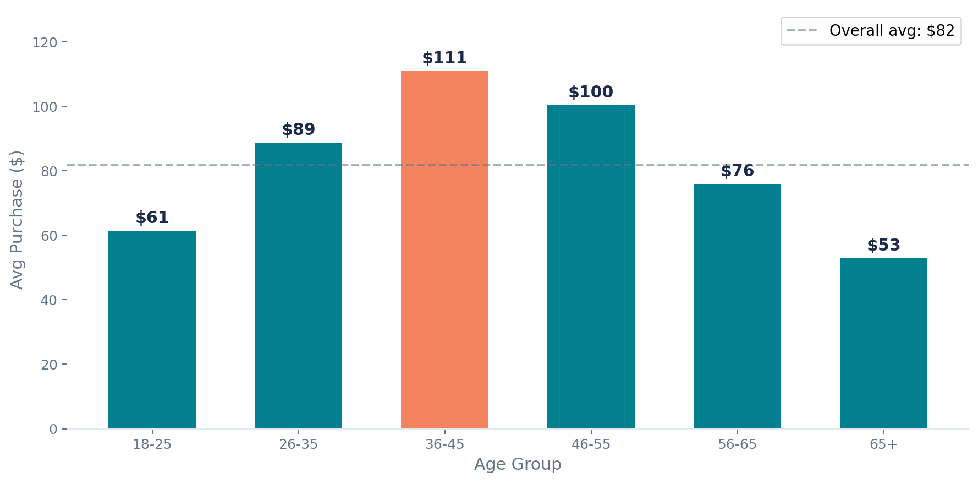
Visualization 1 — Who Spends the Most?
Average purchase amount across generational cohorts
TREND · SPENDING
Key Findings
🏆
Peak Earners
36–45 age group tops at $111 avg — peak earning & family expenditure years
📉
Youth Budget
18–25 group spends just $61 — entry-level incomes & student budgets
🎯
110% Gap
Highest vs lowest spenders differ by over 2× in avg transaction value
💡
Implication
Premium products should target 36–45; value offers resonate with 18–25 & 65+

Slide 4
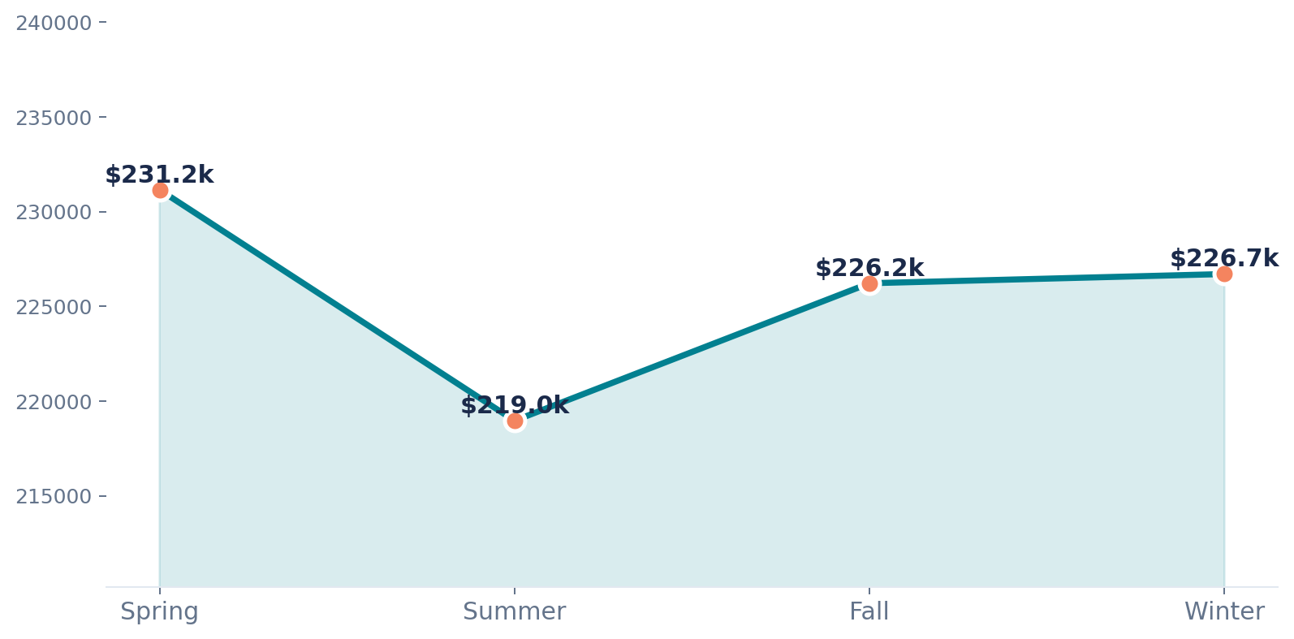
Visualization 1b — Does Season Move the Needle?
Total purchase volume across the four seasons
TREND · SEASONAL
🌸 Spring
$231,154
Highest — post-winter spending surge
☀️ Summer
$218,967
Lowest — surprisingly flat despite holidays
🍂 Fall
$226,223
Steady — back-to-school and events
❄️ Winter
Seasonal variation is narrow (~$12k spread). Demand is year-round — season alone isn't a reliable targeting lever.
$226,709
Strong — holiday gifting season

Slide 5
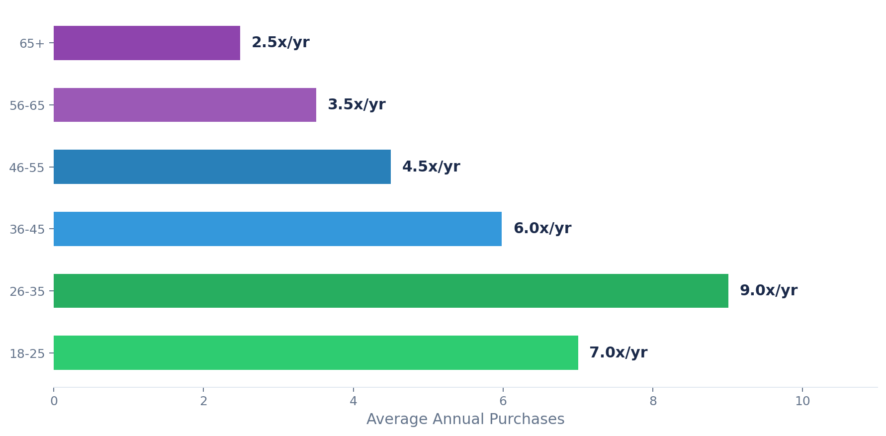
Visualization 2 — Who Shops Most Often?
Purchase frequency reveals engagement, not just spend
COMPARISON · FREQUENCY
Frequency Findings
3.6×
26-35s shop vs 65+ per year
🟢
Digital Natives (18–35)
9x/yr — comfortable with apps, flash sales & subscriptions
🔵
Mid-Life (36–55)
5–6x/yr — intentional but regular purchasing
🟣
Seniors (56+)
Younger segments: flash sales, subscription boxes, gamification. Older segments: curated collections, quality messaging.
2.5–3.5x/yr — deliberate, planned buys over impulse

Slide 6
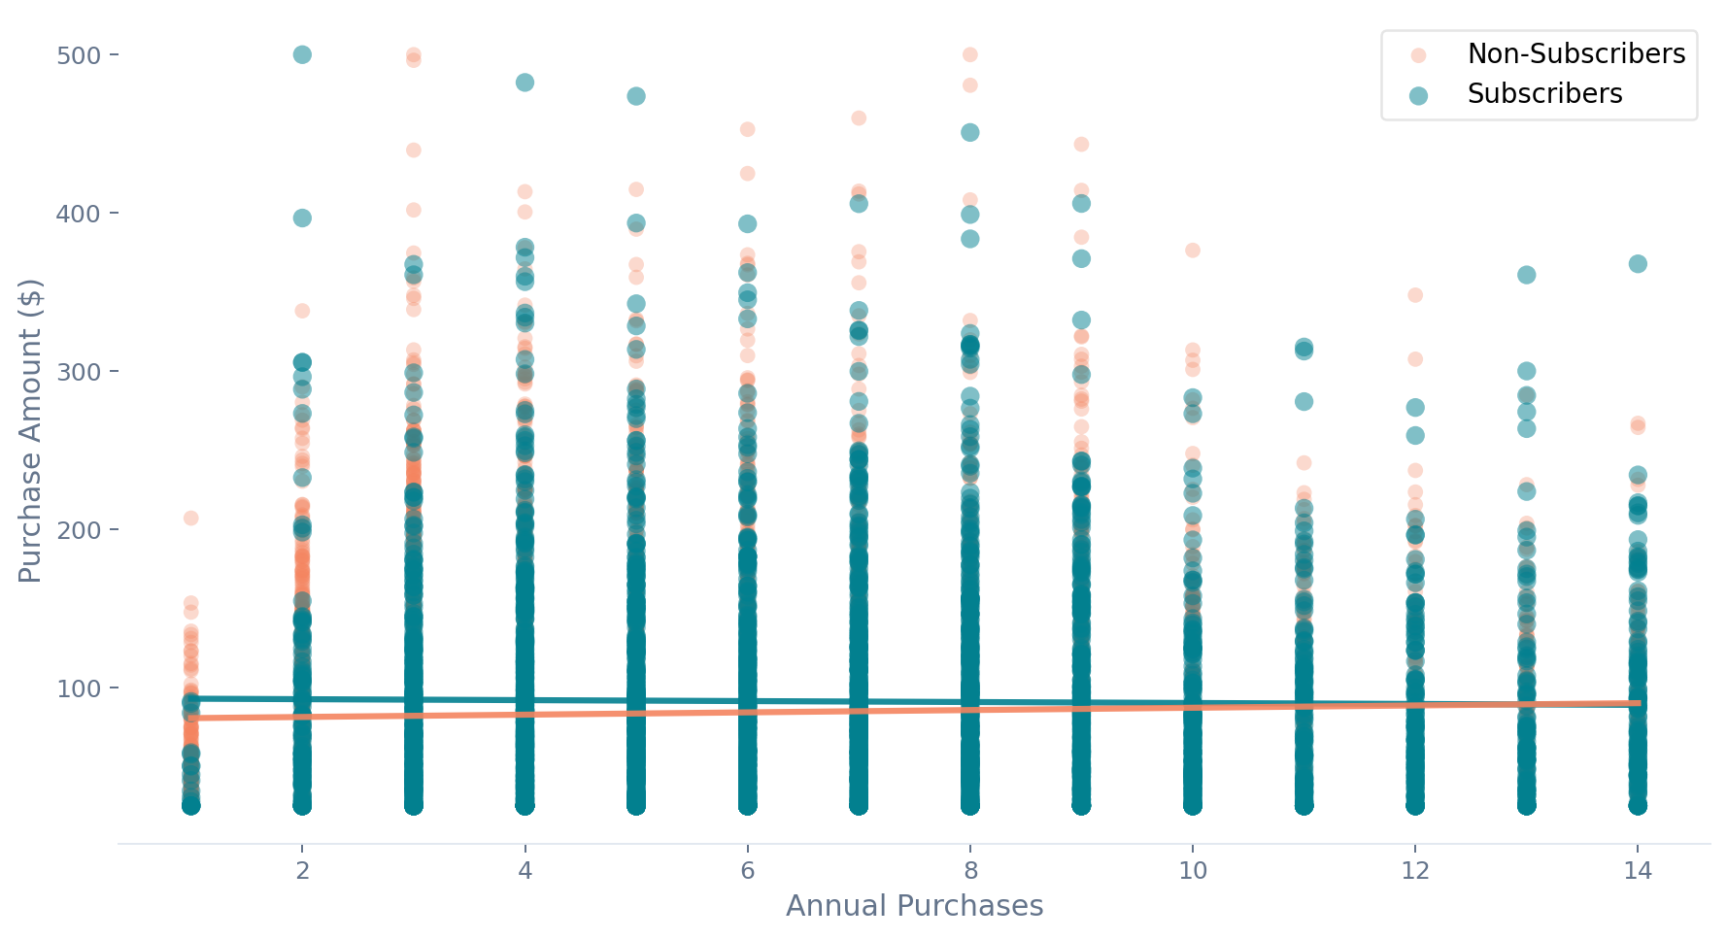
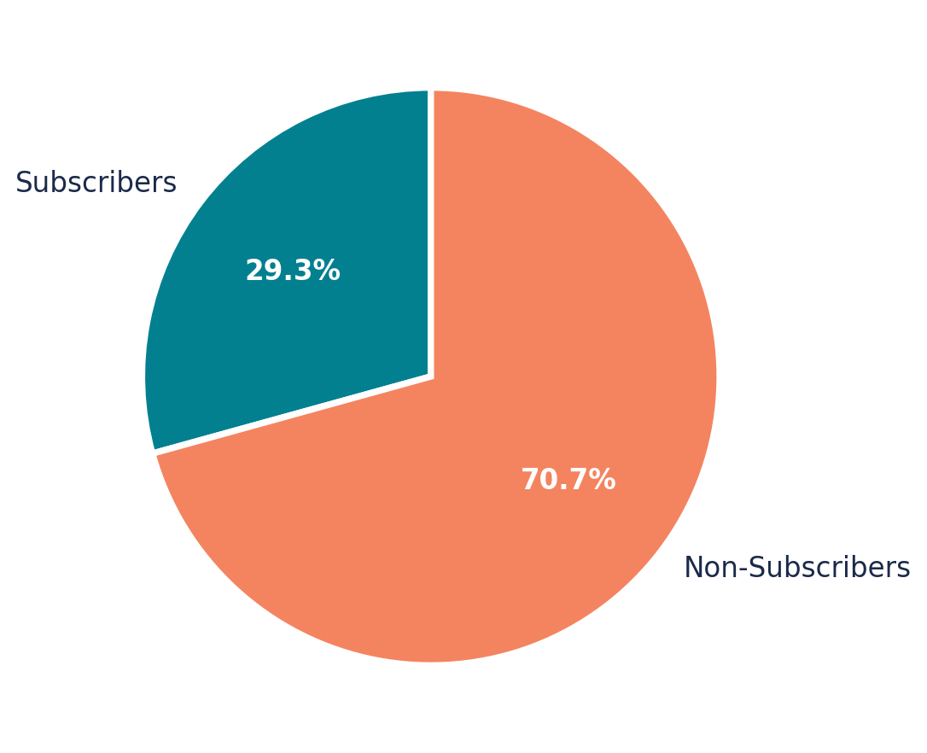
Visualization 3 — The Subscription Effect
Do subscribers spend more and shop more often?
RELATIONSHIP · SUBSCRIPTION
8.3% spend premium for subscribers · 1.1 more purchases/yr
$90.93
$83.96
Subscriber avg spend
Non-sub avg spend
Subscribers form a virtuous cycle: higher frequency drives higher spend. Target 26–45 for conversion campaigns.

Slide 7
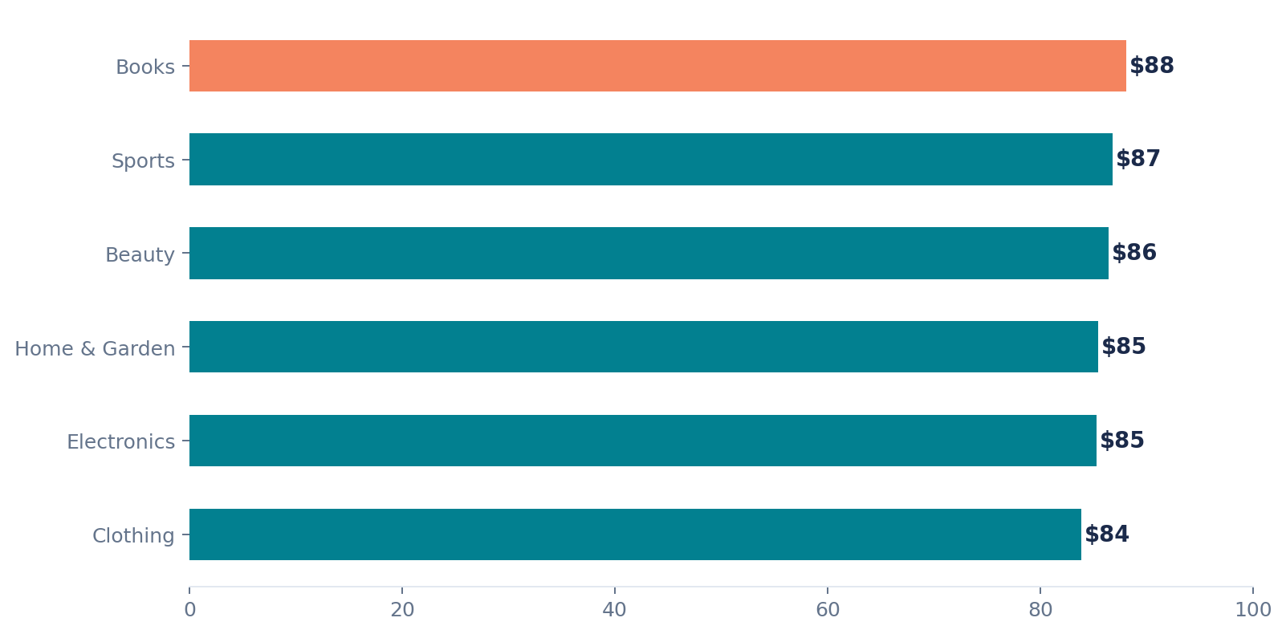
Bonus View — Which Categories Drive the Most Spend?
Average purchase amount by product category
DEEP DIVE · CATEGORIES
Category Insights
📚 Books
$88.10
Top spender per transaction — educational value driver
🏃 Sports
$86.81
Active lifestyle correlates with higher willingness to pay
💄 Beauty
$86.43
Strong repeat-purchase category
🏡 Home & Gard
$85.43
Seasonal peaks in Spring & Fall
💻 Electronics
$85.32
High-intent purchases, lower frequency
👔 Clothing
$83.89
Highest volume, lowest avg spend

Slide 8
The Three-Part Strategy
What the data tells us to do next
STRATEGIC RECOMMENDATIONS
3
🎯 Subscription as North Star
1
💰 Premium Positioning
Target: All, prioritise 26–45
2
🔄 Frequency-First
Target: 36–45 Age Group
Target: 18–35 Age Group
Make subscription conversion the primary KPI
Irresistible first-month trials with exclusive benefits
Design subscription tiers for all budget levels
Track LTV by cohort and optimise continuously
Launch premium product lines for established professionals
Emphasise quality, durability & brand prestige
White-glove service & concierge experiences
Focus ad spend on channels this demo frequents
Aggressive subscription models with perks & discounts
Gamification: points, badges, streaks for engagement
Frequent flash sales & limited-time offers
Optimise mobile — this group shops on the go

Slide 9
Expected Impact
If the three-part strategy is implemented effectively:
📈
🔄
🏆
20–25%
30–40%
50–60%
Increase in average
order value
Boost in purchase
frequency
Improvement in
customer lifetime value
via premium positioning
for the 36–45 segment
via subscription models
targeting younger shoppers
via targeted engagement
and cohort optimisation
Consumer behaviour isn't uniform — it's generational. The businesses that win will understand, target, convert, and optimise.

Slide 10
🔮
The data has spoken.
Now it's time to act.
🔍
🎯
🔄
📊
UNDERSTAND
TARGET
CONVERT
OPTIMISE
demographic segments deeply
with precision, not breadth
casual shoppers into subscribers
continuously from behavioural data

